Slide 1
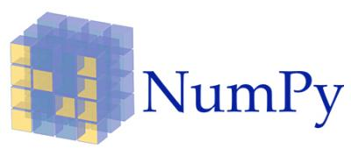
Topic 2
Data Manipulation Using The Numpy Package

Slide 2
Contents
Contents
Intro to Numpy
Creating Numpy arrays
Numpy data types
Inspecting Numpy arrays
Manipulating Array Shapes
Changing array shape
Transpose array
Add/ remove elements
Combine arrays
Split arrays
Converting arrays
Copying Arrays
Sorting Arrays
Subsetting, Slicing and Indexing Numpy arrays
Array Mathematics
Arithmetic operations
Logical operations
Mathematical and Statistical Methods
File I/O on Numpy arrays

Slide 3
Intro to Numpy

Slide 4
What is Numpy?
Intro to Numpy
NumPy (short for numerical Python) is an open source Python library for scientific computing.
It lets you work with arrays and matrices in a natural way
Contains a long list of useful mathematical functions, including some functions for linear algebra, Fourier transformation, and random number generation routines.

Slide 5
Why use NumPy?
Intro to Numpy
NumPy code is much cleaner than regular Python code to accomplish the same tasks. Fewer loops required as operations work directly on arrays and matrices
Has many convenience and mathematical functions that make coding much easier
Underlying algorithms designed with high performance in mind. Large portions of NumPy are written in C. This makes NumPy faster than pure Python code
NumPy's arrays are stored more efficiently than an equivalent data structure in base Python, such as a list of lists. The bigger the array, the more it pays off to use NumPy

Slide 6
A simple application
Intro to Numpy
Imagine that we want to add two vectors called a and b
a = [0,1,4,9,16...] # The vector a holds the squares of integers 0 to n
b = [0,1,8,27,64...] # The vector b holds the cubes of integers 0 to n
def pythonsum(n):
a = list(range(n))
b = list(range(n))
c = [] for i in range(len(a)):
a[i] = i ** 2
b[i] = i ** 3
c.append(a[i] + b[i])
return c
import numpy as np
def numpysum(n):
a = np.arange(n) ** 2
b = np.arange(n) ** 3
c = a + b
return c
Using base Python
Using NumPy
Notes:
def pythonsum1(n):
a=[i**2 for i in range(n)]
b=[i**3 for i in range(n+1)]
#assert len(a) == len(b)
#c=[i + j for i,j in zip(a,b)]
c=[a[i] + b[i] for i in range(0, len(a))]
return c
sum1=pythonsum1(10)
print(sum1)
from time import time
start=time()
sum=pythonsum(100000)
end=time()
print('Time taken 1: {}'.format(end-start))

Slide 7
Numpy Documentation
Intro to Numpy
Official documentation
https://numpy.org/
NumPy Tutorial from W3Schools
https://www.w3schools.com/python/numpy_intro.asp
Notes:
To add

Slide 8
Creating Numpy Arrays

Slide 9
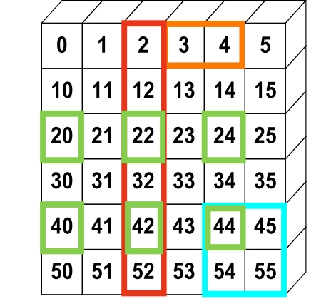
Numpy Array
Intro to Numpy
NumPy provides an N-dimensional array type, the ndarray, which describes a collection of “items” of the same type
The "type" can be any arbitrary structure of bytes and specified using the data type
import numpy as np
# Create a 2-d array (6x6)
a = np.array([(0,1,2,3,4,5),
(10,11,12,13,14,15),
...
(50,51,52,53,54,55)])
print(a[:,2])
[2,12,22,32,42,52]

Slide 10
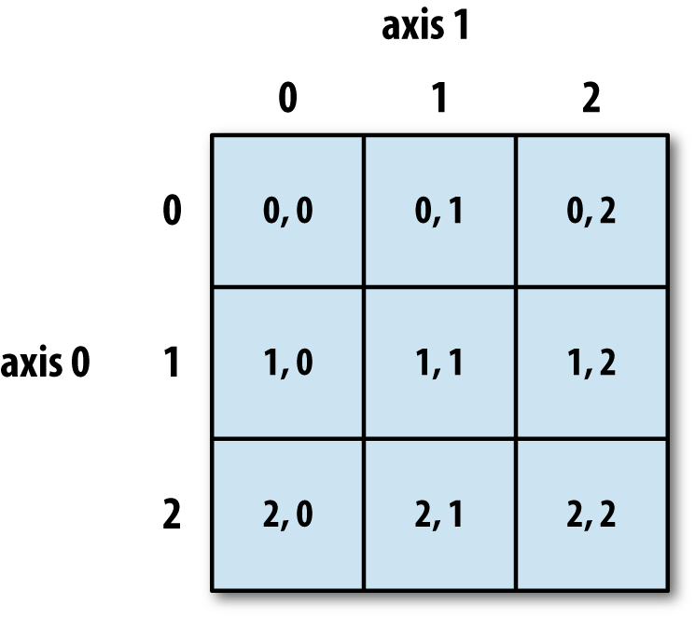
Structure of ndarray
Intro to Numpy
This is an example of a 3x3 ndarray
The size of the array is 9 (i.e. 9 elements inside) and the dimension is 2 (i.e. 2D array)

Slide 11
Using .array() method
Creating Numpy Arrays
import numpy as np
a = np.array([1,2,3]) # Create a 1-d array of integers
b = np.array([(1,2,3),(4,5,6)]) # Create a 2-d array (2x3)
# Create a 1-d array of strings c = np.array(['Apple', 'Orange', 'Pear', 'Durian'])
# Create a 2-d array (2x4) of type float
d = np.array([(1.5,2.5,3.5,4.5),(5.5,6.5,7.5,8.5)],dtype=float)

Slide 12

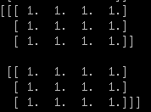
Using zeros() and ones()
Creating Numpy Arrays
import numpy as np
# Create a 3x4 2-d array, with initial value zero
a = np.zeros((3,4))
print(a)
# Create a 2x3x4 3-d array with initial value one
b = np.ones((2,3,4))
print(b)

Slide 13

Using arange()
Creating Numpy Arrays
import numpy as np
# numpy.arange(start,stop,step)
# Create an array that starts from zero and ends at 8
a = np.arange(0,9)
print(a)
# Create array that starts from 10 and ends at 19 with interval 2
c = np.arange(10,20,2)
print(c)
Notes:
https://docs.scipy.org/doc/numpy/reference/generated/numpy.arange.html
@@@

Slide 14
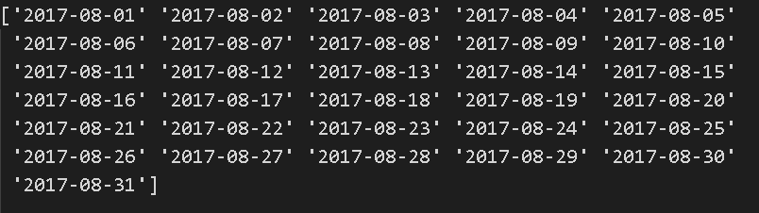
Using arange()
Creating Numpy Arrays
import numpy as np
# Create an array that contains the dates in month of Aug 2017
d = np.arange('2017-08-01','2017-09-01',dtype='datetime64')
print(d)
Notes:
https://docs.scipy.org/doc/numpy/reference/generated/numpy.arange.html

Slide 15
Using linspace()
Creating Numpy Arrays
import numpy as np
# numpy.linspace(start,stop,num)
# Create array that starts with 0 and ends at 2 # with 9 samples in between
d = np.linspace(0,2,9)
print(d)
Notes:
https://docs.scipy.org/doc/numpy/reference/generated/numpy.arange.html
https://docs.scipy.org/doc/numpy/reference/generated/numpy.linspace.html

Slide 16


Using full() and eye()
Creating Numpy Arrays
import numpy as np
# Create a constant array with a specified value # numpy.full(shape, fill_value)
h = 7.0
e = np.full((2,2),h)
print(e)
# Create a 2x2 identity matrix
f = np.eye(2)
print(f)
Notes:
https://docs.scipy.org/doc/numpy/reference/generated/numpy.full.html
https://docs.scipy.org/doc/numpy/reference/generated/numpy.eye.html

Slide 17

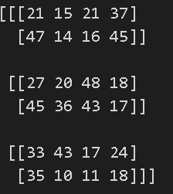
Using random() and randint()
Creating Numpy Arrays
import numpy as np
# Create a 2x2 array with random floats in the interval 0.0 to 1.0 g = np.random.random((2,2))
print(g)
# Create a 3x2x4 array with random numbers # between 10 and 50 (not including 50)
h = np.random.randint(10,50,(3,2,4))
print(h)
Notes:
https://docs.scipy.org/doc/numpy/reference/generated/numpy.random.random.html
https://docs.scipy.org/doc/numpy/reference/generated/numpy.random.randint.html

Slide 18

Using empty()
Creating Numpy Arrays
import numpy as np
# Create a 3x2 empty array
h = np.empty((3,2))
print(h)
Notes:
https://docs.scipy.org/doc/numpy/reference/generated/numpy.random.random.html
https://docs.scipy.org/doc/numpy/reference/generated/numpy.empty.html

Slide 19
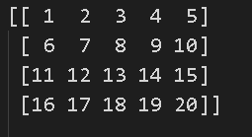
Using reshape()
Creating Numpy Arrays
import numpy as np
# Create 20 numbers from 1 to 20 as a 1-d array
# then reshape this to a 2d array of shape 4x5
a = np.arange(1,21).reshape(4,5)
print(a)

Slide 20
Put different ndarrays into 1 single ndarray
Creating Numpy Arrays
import numpy as np
c1 = np.array([1,2,3,4,5])
c2 = np.arange(2,21,2)
c3 = np.random.randint(1,100,10)
c = np.array([c1,c2,c3])
Practical 2 Section 3

Slide 21
Numpy Data Types
Notes:
https://docs.scipy.org/doc/numpy/reference/arrays.dtypes.html

Slide 22
Numpy Data Types
Data Types
np.int32 | 32-bit integer
np.int64 | 64-bit integer
np.float64 | 64-bit decimal number
np.bool | Boolean type storing TRUE and FALSE values
np.object | Python object type
np.unicode | Fixed-length Unicode string type

Slide 23

Numpy Data Types
Data Types
import numpy as np
a = np.arange(10)
print(f'type(a) is {type(a)}')
print(f'a.dtype is {a.dtype}')

Slide 24
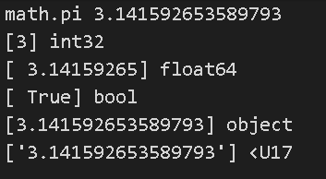
Numpy Data Types
Data Types
import numpy as np
import math
a = np.array([math.pi],dtype=np.int32)
b = np.array([math.pi],dtype=np.float64)
c = np.array([math.pi],dtype=np.bool)
d = np.array([math.pi],dtype=np.object)
e = np.array([math.pi],dtype=np.unicode)

Slide 25
Inspecting your array

Slide 26

shape
Inspecting your array
import numpy as np
# Create 3 arrays with different shapes
a = np.array([1,2,3])
b = np.array([(1,2,3),(4,5,6)])
c = np.array([[(1,2,3,4),(5,6,7,8)], [(9,10,11,12),(13,14,15,16)]])
#shape returns the number of elements in each dimension
print(a.shape)
print(b.shape)
print(c.shape)
Notes:
The shape of an array is the number of elements in each dimension.

Slide 27
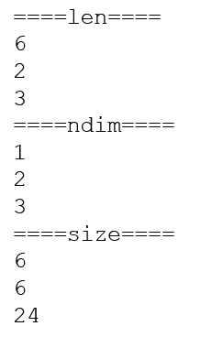
len, ndim, size
Inspecting your array
import numpy as np
# Create 3 arrays with different shapes and sizes
a = np.array([1,2,3,4,5,6])
b = np.array([(1,2,3),(4,5,6)])
c = np.array([[(1,2,3,4),(5,6,7,8)],
[(9,10,11,12),(13,14,15,16)],
[(17,18,19,20),(21,22,23,24)]])
# Size of the first dimension
print('====len====')
print(len(a));print(len(b));print(len(c))
# Number of dimensions
print('====ndim====')
print(a.ndim);print(b.ndim);print(c.ndim)
# Total number of elements across dimensions
print('====size====')
print(a.size);print(b.size); print(c.size)
Practical 2 Section 4

Slide 28
Functions to manipulate array shapes
Manipulating Array Shapes
CHANGE ARRAY SHAPE
flatten()
reshape()
shape()
resize()
COMBINE ARRAYS
concatenate
ADD/REMOVE ELEMENTS
append()
insert()
delete()
TRANSPOSE ARRAY
transpose

Slide 29
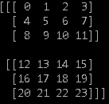
Change array shape - flatten()
Manipulating Array Shapes
Use this function to convert your M-D array to a 1-D array
Return value is a copy of the original array
import numpy as np
b = np.arange(24).reshape(2,3,4) # b= [[[0,1,2,3],[4,5,6,7],[8..],[20,21,22,23]]]
c = b.flatten()
print(b)
print(c) #[ 0 1 2 3 4 5 6 7 8 9 10 11 12 13 14 15 16 17 18 19 20 21 22 23]
c[0] = 100; # change the first value in the copy
print(b)
print(c) #[ 100 1 2 3 4 5 6 7 8 9 10 11 12 13 14 15 16 17 18 19 20 21 22 23]

Slide 30
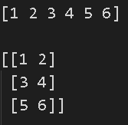
Change array shape - reshape()
Manipulating Array Shapes
reshape gives a new shape to an array without changing its data. It creates a new array and does not modify the original array itself
import numpy
my_array = numpy.array([1,2,3,4,5,6])
print(my_array)
print()
print(numpy.reshape(my_array,(3,2)))
Notes:
What is the difference between reshape(), resize()?

Slide 31
shape
Manipulating Array Shapes
The shape attribute an be used to get array dimensions or to change array dimensions
import numpy as np
a= np.array([1, 2, 3, 4, 5])
print(a.shape) #(5,) -> 5 rows and 0 columns
b = np.array([[1, 2],[3, 4],[6,5]])
print(b.shape) #(3, 2) -> 3 rows and 2 columns

Slide 32
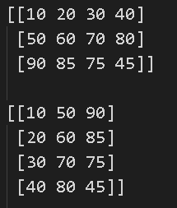
transpose()
Manipulating Array Shapes
The transpose of an array can be obtained by using transpose() method
transpose() is both a library level function and an instance method.
It can be called as numpy.transpose(ndarray) or numpy.ndarray.transpose().
ndarray has an attribute named ‘T’, which returns the transpose of the array.
import numpy as np
x = np.array(([10,20,30,40], [50,60,70,80], [90, 85, 75, 45]))
print(x)
print(x.transpose())
print(np.transpose(x))
print(x.T)

Slide 33
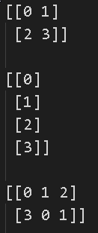
resize()
Manipulating Array Shapes
The resize() method works just like the reshape() function, but modifies the array it operates on:
import numpy as np
a=np.array([[0,1],[2,3]]) #2x2
a = np.resize(a,(4,1))
a = np.resize(a,(2,3)) # not allow in reshape
Practical 2 Section 5

Slide 34

concatenate() - 1-d arrays
Manipulating Array Shapes
Two or more arrays can be concatenated using concatenate() function along an axis
The arrays must have the same shape, except in the dimension corresponding to axis (the first, by default).
numpy.concatenate((a1, a2, ...), axis=0)
import numpy as np
# 1-D array
x = np.arange(5)
y = np.arange(6,10)
z = np.arange(11,15)
print(x);print(y); print(z)
print(np.concatenate((x,y,z)))
Notes:
https://docs.scipy.org/doc/numpy-1.13.0/reference/generated/numpy.concatenate.html
import numpy as np
# 1-D array
x = np.arange(8)
y = np.arange(6,10).reshape(2,2)
z = np.arange(11,15)
print(x);print(y); print(z)
print(np.concatenate((x,y,z)))

Slide 35
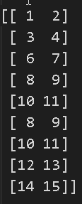

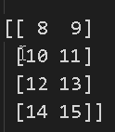
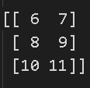
concatenate() 2-d arrays on axis=0
Manipulating Array Shapes
import numpy as np
# Reshaped to 2-D
x = np.arange(1,5).reshape(2,2)
y = np.arange(6,12).reshape(3,2)
z = np.arange(8,16).reshape(4,2)
print(x)
print(y)
print(z)
print(np.concatenate((x,y,z)))
Notes:
https://docs.scipy.org/doc/numpy-1.13.0/reference/generated/numpy.concatenate.html

Slide 36
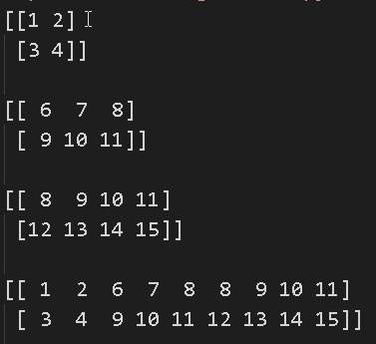
concatenate() - 2-d arrays on axis=1
Manipulating Array Shapes
import numpy as np
x = np.arange(1,5).reshape(2,2)
y = np.arange(6,12).reshape(2,3)
z = np.arange(8,16).reshape(2,4)
print(x)
print(y)
print(z)
print(np.concatenate((x,y,z),axis=1))
Notes:
https://docs.scipy.org/doc/numpy-1.13.0/reference/generated/numpy.concatenate.html

Slide 37
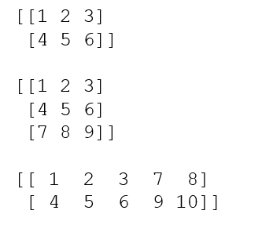
append()
Manipulating Array Shapes
Append values to the end of an array
values must be of the correct shape (the same shape as arr, excluding axis)
If axis is not specified, values can be any shape and will be flattened before use.
import numpy as np
x = np.array([(1,2,3), (4,5,6)])
print(x);print()
x1 = np.append(x, np.array([(7,8,9)]),axis = 0)
x2 = np.append(x, np.array([(7,8), (9,10)]),axis = 1)
print(x1);print()
print(x2);print()
numpy.append(arr, values, axis=None)
Notes:
https://docs.scipy.org/doc/numpy-1.13.0/reference/generated/numpy.append.html

Slide 38
Functions to split arrays
Splitting arrays
split() | This function splits one-dimensional arrays as columns to create a two-dimensional array
hsplit() | This function splits arrays horizontally
vsplit() | This function splits arrays vertically
Notes:
here

Slide 39
split
Splitting arrays
numpy.split(array, indices_or_sections, axis=0)
Split an array into multiple sub-arrays.
import numpy as np
x = np.arange(9.0)
y = np.split(x, 3)
print(x)
print(y)
Notes:
https://docs.scipy.org/doc/numpy-1.13.0/reference/generated/numpy.split.html

Slide 40
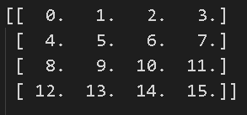
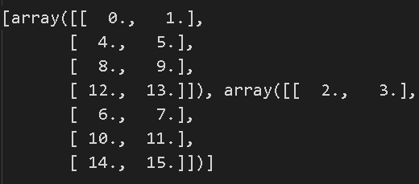
hsplit
Splitting arrays
Split an array into multiple sub-arrays horizontally (column-wise)
Equivalent to split with axis=1, the array is always split along the second axis regardless of the array dimension
import numpy as np
x = np.arange(16.0).reshape(4, 4)
y = np.hsplit(x, 2)
print(x)
print(y)
Notes:
https://docs.scipy.org/doc/numpy-1.13.0/reference/generated/numpy.hsplit.html

Slide 41
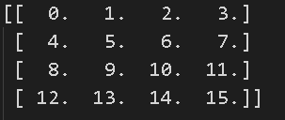
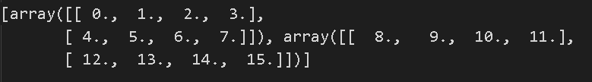
vsplit
Splitting arrays
Split an array into multiple sub-arrays vertically (row-wise)
equivalent to split with axis=0 (default), the array is always split along the first axis regardless of the array dimension
import numpy as np
x = np.arange(16.0).reshape(4, 4)
y = np.vsplit(x, 2)
print(x)
print(y)
Practical 2 Section 6
Notes:
https://docs.scipy.org/doc/numpy-1.13.0/reference/generated/numpy.vsplit.html

Slide 42
Copying arrays

Slide 43

numpy.copy
Copying Arrays
import numpy as np
# Create 2 arrays with different data types, shapes and sizes
a = np.array([10,2,8,4,6,1,5,9,3,7]) b = np.array([("Red","Blue","Yellow"),("Green","Cyan","Magenta")])
npc = np.copy(a)
npc.sort()
print(a)
print(npc)
Practical 2 Section 7

Slide 44
Sorting arrays

Slide 45

Sorting arrays
Sorting Arrays
import numpy as np
# Create 2 arrays with different data types, shapes and sizes
a = np.array([10,2,8,4,6,1,5,9,3,7]) b = np.array([("Red","Blue","Yellow"),("Green","Cyan","Magenta")])
a.sort()
b.sort(axis=1)#column
print(a)
print(b)
Practical 2 Section 8
Notes:
https://docs.scipy.org/doc/numpy/reference/generated/numpy.full.html
https://docs.scipy.org/doc/numpy/reference/generated/numpy.eye.html

Slide 46
Subsetting, Slicing and Indexing

Slide 47
One-dimensional slicing and indexing
Subsetting, Slicing and Indexing
import numpy as np
a = np.arange(9) # a = [0,1,2,3,4,5,6,7,8]
# Select the element at index 2
print(a[2]) # 2
# Select elements from index 0 to 7 with step 2
print(a[:7:2]) # 0 2 4 6
# Select and reverse elements from index 0 to the end
print(a[::-1]) # 8 7 6 5 4 3 2 1

Slide 48
Multi-dimensional Slicing and indexing 1
Subsetting, Slicing and Indexing
import numpy as np
# Create an array with 0 to 23 and reshape it into a 2x3x4 array # Think of it as an Excel workbook with 2 worksheets
# Each worksheet has 3 rows,4 columns
b = np.arange(24).reshape(2,3,4)
print(b)

Slide 49
Multi-dimensional Slicing and indexing 1
Subsetting, Slicing and Indexing
# Select worksheet 2, Row 2, Col 4
print(b[1,1,3]) # 19
# Select both worksheets, Row 1, Col 1
print(b[:,0,0]) # 0 12
# Select first worksheet, all rows and columns
# Method 1
print(b[0])
# Method 2
print(b[0, :, :])
# Method 3, Ellipsis replaces the multiple colons
print(b[0, ...])
Notes:
Stop here

Slide 50
Multi-dimensional Slicing and indexing 2
Subsetting, Slicing and Indexing
# Select first worksheet, second row, all columns
print(b[0,1]) # 4 5 6 7
# Select first worksheet, all rows, second column
print(b[0,:,1]) # 1 5 9
# Select every 2 elements in first worksheet, 2nd row, all cols
print(b[0,1,::2]) # 4 6
# Select all worksheets, all rows, 2nd col
print(b[...,1]) # 1 5 9 13 17 21
# Select 2nd row elements, regardless of worksheet and col
print(b[:,1,:]) # 4 5 6 7 16 17 18 19
# Select 1st worksheet, all rows, last column
print(b[0,:,-1]) #3 7 11

Slide 51
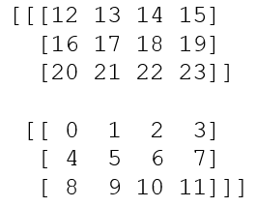
Multi-dimensional Slicing and indexing 3
Subsetting, Slicing and Indexing
# Select first worksheet, all rows, last col, but in reverse
print(b[0,::-1, -1]) # 11 7 3
# Select 1st worksheet, last col, every 2 rows print(b[0,::2,-1]) # 3 11
# Select all worksheets in reverse, all rows, all col
print(b[::-1])

Slide 52
Boolean Indexing
Subsetting, Slicing and Indexing
Boolean indexing lets you indicate if an element should be included
In the example below, we want to create an array with only the even numbers
import numpy as np
a = np.arange(6).reshape(2,3)
b = a % 2 == 0
a = a[b]
print(a)

Slide 53
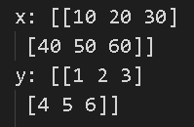
Arithmetic operators
Arithmetic and Logical operations on Arrays
The standard arithmetic operators such as: +, -, *, /, **, % are applied on individual elements, so, the arrays have to be of the same size
import numpy as np
x = np.array(([10,20,30], [40,50,60]))
y = np.array(([1,2,3], [4,5,6]))
print(x) print(y)
print(x+y)
print(x-y)
print(x*y)
print(x/y)
print(x%y)

Slide 54
Logical operators
Arithmetic and Logical operations on Arrays
Similarly, logical operators >, < , == are applied on individual elements, so arrays have to be of same size
import numpy as np
x = np.array(([10,20,30], [40,50,60]))
y = np.array(([1,2,3], [4,5,6]))
print(x) print(y)
print(x>y)
print(x<y)
print(x==y)
Practical 2 Section 10

Slide 55
Mathematical and Statistical Methods
Mathematical and Statistical Methods
sum() | Sum of all the elements in the array or along an axis. Zero-length arrays have sum 0.
mean() | Arithmetic mean. Zero-length arrays have NaN mean.
median()
cumsum() | Return the cumulative sum of the elements along a given axis.
cumprod() | This function stacks one-dimensional arrays as columns to create a two-dimensional array
std, var | Returns the standard deviation, a measure of the spread of a distribution, of the array elements Returns the variance of the array elements, a measure of the spread of a distribution
min,max | Return the minimum, maximum along a given axis
argmin, argmax | Return indices of the minimum, maximum values along the given axis

Slide 56
sum()
Mathematical and Statistical Methods
Sum of all the elements in the array or along an axis
Zero-length arrays have sum 0
numpy.sum(a, axis=None, dtype=None, out=None, keepdims=<class numpy._globals._NoValue>)
import numpy as np
b = np.arange(24).reshape(6,4) # b= [[[0,1,2,3],[4,5,6,7],[8..],[20,21,22,23]]]
print(b.sum()) # 276

Slide 57
mean()
Mathematical and Statistical Methods
Sum of all the elements in the array or along an axis
Zero-length arrays have mean 0
import numpy as np
b = np.arange(24) # b= [0,1,2,3,4,... 23]
print(b.mean()) # 11.5

Slide 58

median()
Mathematical and Statistical Methods
numpy.median(a, axis=None, out=None, overwrite_input=False, keepdims=False)
Compute the median along the specified axis.
Returns the median of the array elements
import numpy as np
a = np.array([[10, 7, 4], [3, 2, 1]])
median = np.median(a)
print(median)
Notes:
https://docs.scipy.org/doc/numpy-1.13.0/reference/generated/numpy.median.html

Slide 59
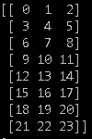


min(), max()
Mathematical and Statistical Methods
ndarray.min(axis=None, out=None, keepdims=False)
ndarray.max(axis=None, out=None, keepdims=False)
import numpy as np
b = np.arange(24).reshape(8,3)
print(b.min())
print(b.min(axis=0))
print(b.min(axis=1))
print(b.max())
print(b.max(axis=0))
print(b.max(axis=1))

Slide 60


argmin(), argmax()
Mathematical and Statistical Methods
numpy.argmin(a, axis=None, out=None)
numpy.argmax(a,axis=None, out=None)
import numpy as np
b = np.arange(24).reshape(8,3)
print(b)
print(b.argmin())
print(b.argmin(axis=0))
print(b.argmin(axis=1))
print(b.argmax())
print(b.argmax(axis=0))
print(b.argmax(axis=1))

Slide 61

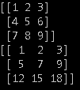
cumsum()
Mathematical and Statistical Methods
Return the cumulative sum of the elements along a given axis
numpy.cumsum(a, axis=None, dtype=None, out=None)
import numpy as np
a = np.array([[1,2,3], [4,5,6]])
print(a)
b = np.cumsum(a)
print(b) # [1 3 6 10 15 21]
c = np.arange(1,10).reshape(3,3)
print(c)
d = np.cumsum(c,axis=0)
print(d)

Slide 62
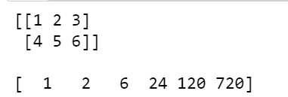
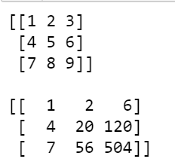
cumprod()
Mathematical and Statistical Methods
Return the cumulative product of the elements along a given axis
numpy.cumprod(a, axis=None, dtype=None, out=None)
import numpy as np
a = np.array([[1,2,3], [4,5,6]])
print(a)
b = np.cumprod(a)
print(b) #[1 2 6 24 120 720]
c = np.arange(1,10).reshape(3,3)
print(c)
d = np.cumprod(c,axis=1)
print(d)

Slide 63
std()
Mathematical and Statistical Methods
Compute the standard deviation along the specified axis
numpy.cumprod(a, axis=None, dtype=None, out=None)
import numpy as np
a = np.array([[1,2,3], [4,5,6]])
print(a)
b = np.std(a)
print(b)
Notes:
https://docs.scipy.org/doc/numpy-1.13.0/reference/generated/numpy.std.html

Slide 64
var()
Mathematical and Statistical Methods
Compute the variance along the specified axis
numpy.var(a, axis=None, dtype=None, out=None, ddof=0)
import numpy as np
a = np.array([[1,2,3], [4,5,6]])
print(np.var(a))
print(np.var(a, axis=0))
print(np.var(a, axis=1))
print(np.var(a, axis=1,dtype=np.float32))
print(np.var(a, axis=1,dtype=np.float64))
Practical 2 Section 11
Notes:
print(np.var(a, axis=1,dtype=np.float32))
print(np.var(a, axis=1,dtype=np.float64))

Slide 65
File Input and Output with Arrays
File Input and Output with Arrays
NumPy is able to save and load data in both text and binary format
Function | Description
load() | Load a Numpy array from disk
save() | Save a Numpy array to a binary file
savez() | Save several arrays into a single file in uncompressed .npz format.
Function | Description
loadtxt(filename) | Load data from a text file. Each row in the text file must have the same number of values.
genfromtxt(filename) | Load data from a text file, with missing values handled as specified.
savetxt(filename) | Save an array to a text file.
Notes:
https://docs.scipy.org/doc/numpy/reference/generated/numpy.save.html
https://docs.scipy.org/doc/numpy/reference/generated/numpy.savez.html
https://docs.scipy.org/doc/numpy/reference/generated/numpy.load.html
https://docs.scipy.org/doc/numpy/reference/generated/numpy.loadtxt.html
https://docs.scipy.org/doc/numpy/reference/generated/numpy.genfromtxt.html
https://docs.scipy.org/doc/numpy/reference/generated/numpy.savetxt.html

Slide 66
Using genfromtxt()
File Input and Output with Arrays
import numpy as np
data = np.genfromtxt("data/coe-results.csv",
delimiter=',',
names=True, dtype=('U7', int, 'U10', int, int, int, int))
print(data)
print(data.shape)
Practical 2 Section 12
Notes:
https://numpy.org/devdocs/user/basics.io.genfromtxt.html

Slide 67
The End

